Slide 1
ODE 5 – Boundary Value Problems
AMSC/CMSC 460
Dr. Christopher Moakler

Slide 2
IVP vs. BVP
All of the methods for solving ODEs we’ve looked at so far were for Initial Value Problems.
IVPs are common in science, engineering, etc.
We often know an initial value of some parameter of interest as well as an ODE describing how it changes.
However, there is another type of ODE we haven’t looked at yet, Boundary Value Problems.
These problems have known values at two or more points.
Specifically, these values are known at the endpoints of the solution interval.
The boundary of the interval of interest.
The ODEs describing these problems must be of at least second order.

Slide 3
Examples of BVP
A common example of a BVP is the scenario where you have a metal bar where you fix the temperature at either end of the bar.
Boundary value problems also arise frequently in E&M.
Finding the electric potential or the magnetic potential in a region of space.
They also come up frequently when studying waves of all types.
This includes optical waves, vibrational waves, quantum mechanical waves, etc.
A lot of the applications of BVP are actually for Partial Differential Equations.
In these cases, the boundary isn’t just two points, but rather a curve surrounding a closed region.

Slide 4
Dirichlet and Nuemann boundary conditions
In the example where you have a metal bar with fixed temperatures, the distribution of Temperature in the bar is governed by an ODE.
This is an example of a Dirichlet boundary condition since we know the value of the function at the boundary.
This is also sometimes called a first-type boundary.
Imagine if we instead placed a heater at either end of the bar that supplied energy at a fixed rate.
In this example, we know the rate of change of the temperature at either end.
That is, we know the value of the derivative.
This is an example of a Nuemann boundary condition.
This is also sometimes called a second-type boundary.

Slide 5
Finding the Solution to a BVP
Can we apply the previous methods we’ve studied to these sorts of problems?
In a way, we actually can!
It’s sort of a cheat though…
If we know how to solve one sort of problem, and you come across new similar problem, you should see if you can apply the old method to the new one.
In this case, can we convert the BVP into an IVP?
How?

Slide 6
A Simple Example
Say we have a BVP
$$\ddot{y}=f\left(t,y,\dot{y}\right)$$
$$y\left(a\right)=y_{a}$$
$$y\left(b\right)=y_{b}$$
We have a second order ODE which requires two conditions to yield a unique solution.
We have those!
But they’re on the boundary…
Let’s make an analogy to our physical intuition.
Consider a projectile fired into the air and we know its initial and final position.
I’ll draw this on the board for us.

Slide 8
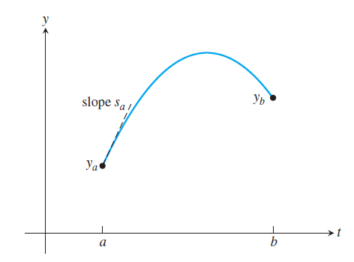
A Simple Example cont
We con convert our BVP into an IVP!
We do this by taking the known initial value and guessing the derivative of the function at the initial value.
That is, we use,
$$y\left(a\right)=y_{a}$$
$$\dot{y}\left(a\right)=s_{a}$$
We than use an IVP ODE solver to find $y\left(b\right)$.
Since we know the value this should be, we can find the error in our guess.
What next?
Sauer

Slide 9
Shooting Method
To solve a BVP we convert it into an IVP,
$$y\left(a\right)=y_{a}$$
$$\dot{y}\left(a\right)=s_{a}$$
We make an initial guess for $s_{a}$ and use one of the previous ODE solvers to forward integrate to find an approximate $y\left(b\right)$
We then define a function
$$F\left(s\right)=y\left(b\right) −y_{b}$$
where $y\left(b\right)$ is the approximated value from the IVP and $y_{b}$ is the boundary condition.
We then use one of the equation solving methods we studied in the first section of this course to find the zero of $F\left(s\right)$.

Slide 10
Shooting Method Example
Sauer

Slide 11
Another Shooting Method Example
Find the solution to the BVP
$$\ddot{y}=4y; y\left(0\right)=1; y\left(1\right)=3$$
To use our IVP methods, we need to convert this into a system of first-order ODEs
$$y_{1}=\dot{y}$$
$${\dot{y}}_{1}=4y$$
To solve this in Matlab, we define the function $F\left(s\right)$,
function z=F(s)
a=0; b=1; yb=3;
ydot = @(t,y) [y(2);4*y(1)];
[t,y] = ode45(ydot,[a,b],[1,s]);
z = y(end,1)-yb;
end
This uses Matlab’s ode45 to solve the system above.

Slide 12
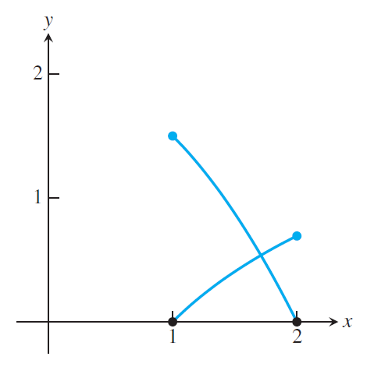
Another Shooting Method Example cont
We need to find values that bracket the root of $F\left(s\right)$.
In this example $F\left(−1\right)≈−1.05$ and $F\left(0\right)≈0.76$
We can plug these into the Matlab equation solver
sstar=fzero(@F,[-1,0])
The @F is the function handle for F which Matlab needs to solve this.
Matlab finds $s_{∗}≈−0.4203$.
This is an excellent example of a situation where evaluating the function can be VERY costly for the root solving methods we discussed earlier in the semester.
At every iteration, we need to solve an entire ODE!
Sauer

Slide 13
Finite Difference Methods
Another approach we can take is to approximate the ODE using the Finite Difference Equations from previous lectures.
We’ll need,
$$\dot{y}\left(t\right)=\frac{y\left(t+h\right)−y\left(t−h\right)}{2h}−\frac{h^{2}}{6}\overset{⃛}{y}\left(c\right)$$
and,
$$\ddot{y}\left(t\right)=\frac{y\left(t+h\right)−2y\left(t\right)+y\left(t−h\right)}{2h^{2}}−\frac{h^{2}}{12}y′′′′\left(c\right)$$
After substituting our approximations, we form a system of equations which we can solve to find an approximation of our desired solution.

Slide 14
Finite Difference Methods Graphically
Sauer

Slide 15
Finite Difference Method Example
Find the solution to the BVP
$$\ddot{y}=4y; y\left(0\right)=1; y\left(1\right)=3$$
We substitute the approximation of $\ddot{y}$ and get,
$$\frac{w_{i+1}−2w_{i}+w_{i−1}}{h^{2}}−4w_{i}=0$$
We can rearrange and get,
$$w_{i−1}+\left(−4h^{2}−2\right)w_{i}+w_{i+1}=0$$
Let’s approximate the solution on 3 points, thus the step size is $h=\frac{1}{4}$.

Slide 16
Finite Difference Method Example cont
This gives us the system
$$w_{0}+\left(−4h^{2}−2\right)w_{1}+w_{2}=0$$
$$w_{1}+\left(−4h^{2}−2\right)w_{2}+w_{3}=0$$
$$w_{2}+\left(−4h^{2}−2\right)w_{3}+w_{4}=0$$
Here is where we plug in our boundary conditions, $w_{0}=1$ and $w_{4}=3$.
$$1+\left(−4h^{2}−2\right)w_{1}+w_{2}=0$$
$$w_{1}+\left(−4h^{2}−2\right)w_{2}+w_{3}=0$$
$$w_{2}+\left(−4h^{2}−2\right)w_{3}+3=0$$
So, we have 3 unknowns and 3 equations.
Let’s plug in $h=\frac{1}{4}$ and find the matrix form of this.

Slide 17
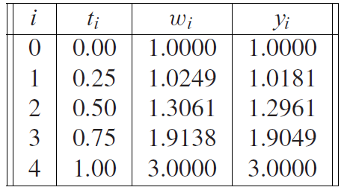
Finite Difference Method Example cont
In matrix form, we get a tri-diagonal system,
$$\left[\begin{matrix}−\frac{9}{4} & 1 & 0 \\ 1 & −\frac{9}{4} & 1 \\ 0 & 1 & −\frac{9}{4}\end{matrix}\right]\left[\begin{matrix}w_{1} \\ w_{2} \\ w_{3}\end{matrix}\right]=\left[\begin{matrix}−1 \\ 0 \\ −3\end{matrix}\right]$$
We can solve this using any of the methods we previously studied.
If we use Gaussian Elimination, we get approximate values of
$$w_{1}=1.0249, w_{2}=1.3061, w_{3}=1.9138$$
Let’s compare, to the true solution,
Sauer

Slide 18
Finite Difference Method Example cont
If we wanted more accuracy, we can simply add additional intervals.
For this example, the general form looks like,
where $h=\frac{1}{n+1}$.
Sauer

Slide 19
Finite Difference Method in General
We can take any BVP and substitute in an approximation of the derivative.
We then discretize the region and solve the system of equations that results.
We can use Gaussian Elimination to solve for approximate values of the solution function.
We can also use one of the iterative methods instead.
If we have a large region or need values at many points, we may have a large system to solve.
The iterative methods can offer good performance in these cases.

Slide 20
Non-linear BVP
If we have a linear ODE, we will also get a linear system of equations to solve.
If instead we have a non-linear ODE, we will end up with a non-linear system of equations we need a solution for.
We can use the Multivariate Newton’s Method to solve such a system.
I may have briefly mentioned this previously, but I won’t go into the details.
Essentially, we convert the system into finding the minimum of a multivariable function.

Slide 21
Collocation
Another approach we can take is to guess the form of the solution using a candidate solution,
$$y\left(t\right)=c_{1}φ_{1}\left(t\right)+c_{2}φ_{2}\left(t\right)+…+c_{n}φ_{n}\left(t\right).$$
We then evaluate this function at $n$ values of $t$.
This gives us $n$ equations for the $n$ values of $c_{i}$.
We can solve this system to get values for the coefficients which approximate our solution.

Slide 22
Collocation Basis Functions
We need a way to choose the $φ_{i}$ in the candidate solution,
$$y\left(t\right)=c_{1}φ_{1}\left(t\right)+c_{2}φ_{2}\left(t\right)+…+c_{n}φ_{n}\left(t\right).$$
These $φ_{i}$ are a set of basis functions.
It’s not recommended that you use polynomials as your basis functions.
They are susceptible to the Runge Phenomena.
We can overcome this slightly if we use the Chebyshev nodes as our evaluation points.
In Sauer, he has an example using monomials as the basis functions.
This has the advantage of having easily calculable derivatives.
However, the non-orthogonality of monomials makes the coefficient matrix ill-conditioned.

Slide 23
Collocation Basis Functions cont
It would be better to use an orthogonal set of basis functions.
One option is to use trigonometric functions as the basis functions.
These lead to Fourier Analysis and spectral methods which we won’t discuss in this class.
They are however very popular for solving BVP as well as PDEs.

Slide 24
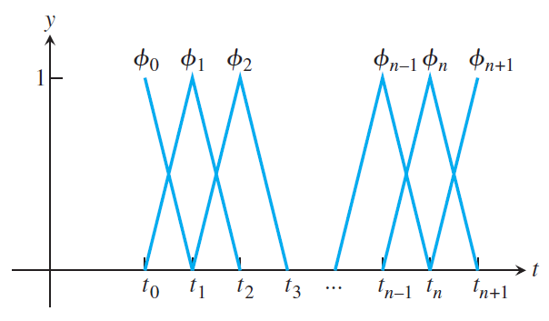
Finite Element Method
The finite element method is a very popular approach for solving BVP and PDEs.
I won’t get too much into the nitty gritty but I will lay out the broad strokes.
The main idea is to use a collection of very simple functions as the basis functions.
These functions are only non-zero for a small sub-region.
Additionally, instead of exactly fitting the ODE at
the various values of $t$, we minimize the error of the
solution.
Sauer

